Slide 1
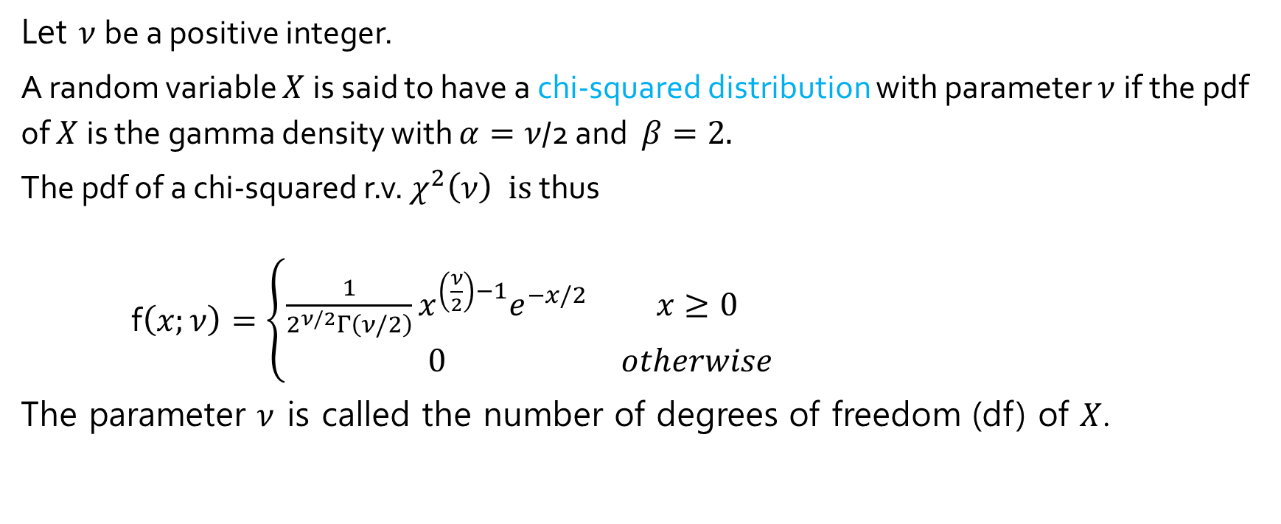
The Chi-squared distribution
Let $ν$be a positive integer.
A random variable $X$is said to have a chi-squared distribution with parameter $ν$if the pdf of $X$is the gamma density with $α=ν$/2 and $β=2.$
The pdf of a chi-squared r.v. $χ^{2}\left(ν\right) is$thus
f$\left(x;ν\right)=\left\{\begin{matrix}\frac{1}{2^{ν/2}Γ\left(ν/2\right)}x^{\left(\frac{ν}{2}\right)−1}e^{−x/2} & x≥0 \\ 0 & otherwise\end{matrix}\right.$
The parameter $ν$ is called the number of degrees of freedom (df) of $X$.

Slide 2
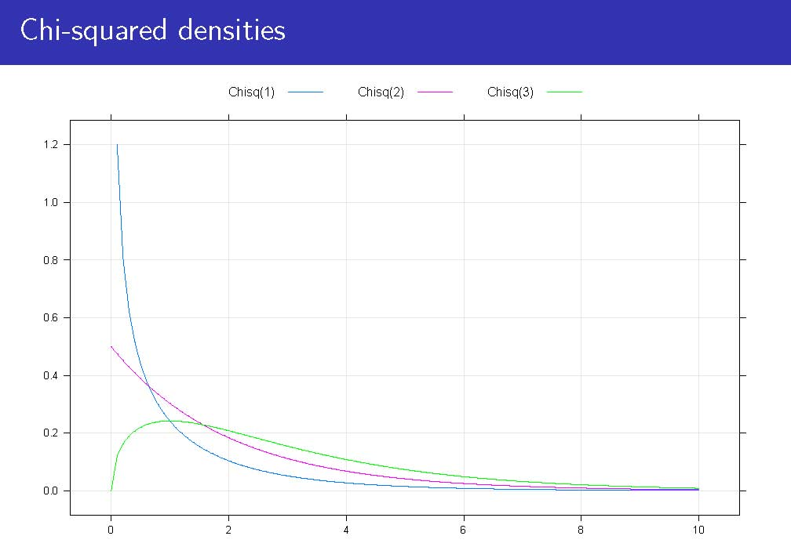
Chi-squared densities

Slide 3
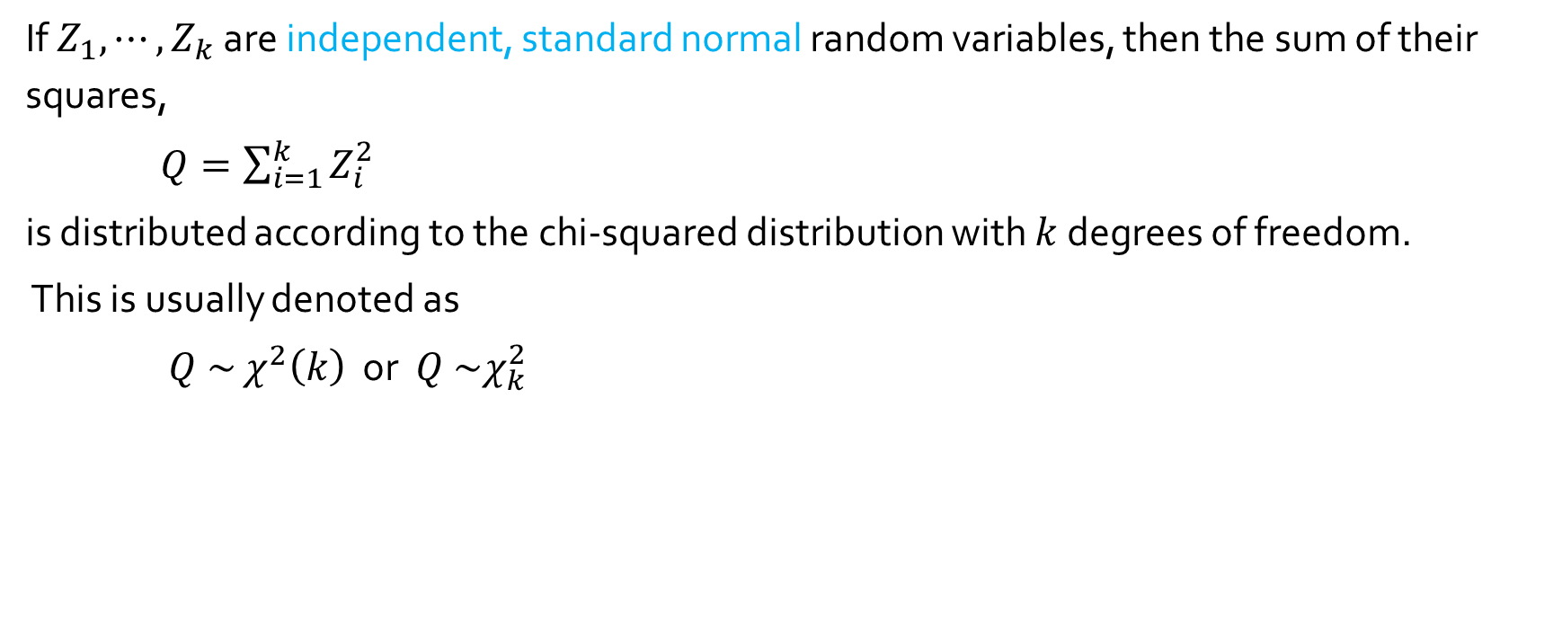
If $Z_{1}, ⋯,Z_{k}$ are independent, standard normal random variables, then the sum of their squares,
$Q=\sum_{i=1}^{k}{Z_{i}^{2}}$
is distributed according to the chi-squared distribution with $k$ degrees of freedom.
This is usually denoted as
$Q \sim$ $χ^{2}\left(k\right)$ or $Q \sim χ_{k}^{2}$

Slide 4
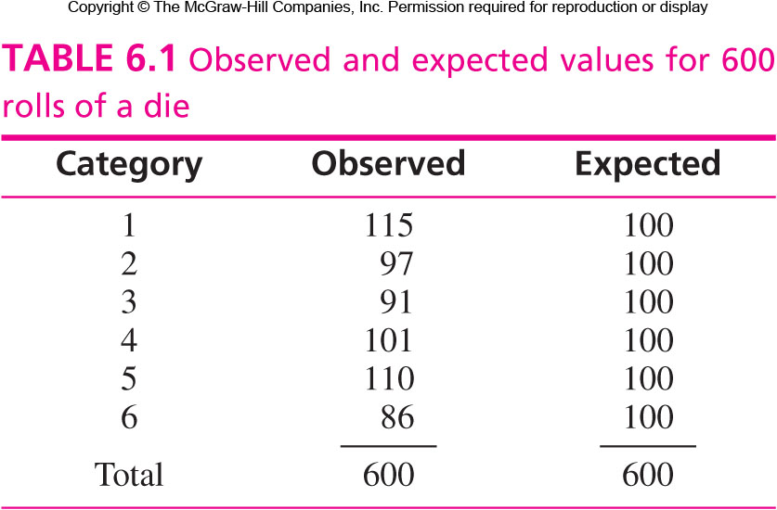
Table 6.1
$$χ^{2}=\frac{{(115−100)}^{2}}{100}+\frac{{(97−100)}^{2}}{100}+⋯+\frac{{\left(86−100\right)}^{2}}{100}=6.12$$

Slide 5
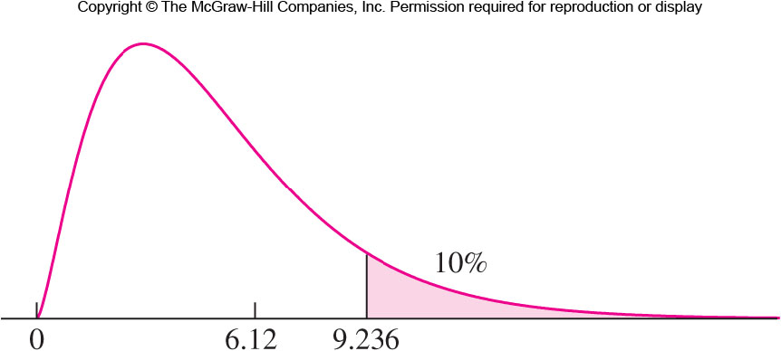
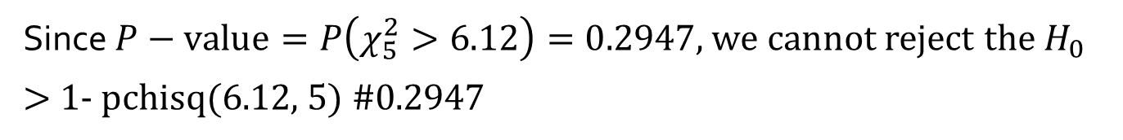
Figure 6.10
Since $P−value=P\left(χ_{5}^{2}>6.12\right)=0.2947,$we cannot reject the $H_{0}$
> 1- pchisq(6.12, 5) #0.2947

